Slide 1

Swift Solve: A Versatile Sudoku Solver for Effortless Puzzle Mastery
SRM Institute of Science and Technology
College of Engineering & Technology | School of Computing
Department of Computing Technologies
18CSC305J Artificial Intelligence – Mini Project
Team Members
RA2111027010018 Hrishikesh
RA2111027010019 Atif Alam Ansari
RA2111027010020 Yash Dixit
RA2111027010021 Vaishnavi Kishor

Slide 2
Abstract
The Sudoku Solver application utilizes advanced algorithms to accurately solve puzzles of varying complexities, enhancing users' gaming experience and promoting logical thinking.
By analyzing and filling missing numbers, the solver ensures that each row, column, and 3x3 sub grid contains all digits from 1 to 9 without repetition.
The application aims to provide an efficient and enjoyable Sudoku-solving experience, leveraging optimization strategies for improved speed and adaptability to diverse puzzle types and sizes.

Slide 3
Introduction
The Sudoku Solver application is built using artificial intelligence (AI) algorithms to solve Sudoku puzzles efficiently and accurately.
The solver employs constraint satisfaction algorithms to analyze the puzzle grid and fill in missing numbers while adhering to the rules of Sudoku.
These algorithms ensure that each row, column, and 3x3 subgrid contains all digits from 1 to 9 without repetition, ultimately leading to a complete and correct solution.

Slide 4
Introduction
The Sudoku Solver application utilizes various technologies, including:
Constraint Satisfaction Algorithms: These algorithms are at the core of the solver, ensuring that all constraints of the Sudoku puzzle are satisfied while filling in missing numbers.
Backtracking: Backtracking is used to explore different possible assignments of numbers to cells, efficiently finding a solution to the puzzle.
Optimization Strategies: The solver employs optimization strategies to improve solving speed and adaptability to different puzzle types and sizes. These strategies may include heuristic approaches and pruning techniques to reduce the search space.
Graphical User Interface (GUI): The application features a user-friendly GUI that allows users to input Sudoku puzzles and view the solver's solution in real-time.

Slide 5
Societal Benefits
The Sudoku Solver application provides several societal benefits, including:
Promoting Logical Thinking: By solving Sudoku puzzles, users can improve their logical thinking and problem-solving skills.
Educational Value: The application can be used as an educational tool to teach concepts such as constraint satisfaction and algorithmic problem-solving.
Enhanced Gaming Experience: The solver enhances the gaming experience by providing an efficient and accurate solution to Sudoku puzzles, encouraging users to tackle more challenging puzzles.

Slide 6
Challenges
Despite its benefits, the Sudoku Solver application faces several challenges, including:
Complexity: Solving Sudoku puzzles efficiently requires dealing with the combinatorial complexity of the puzzle space, which can be challenging.
Algorithm Performance: Ensuring that the solver performs optimally for puzzles of varying complexities and sizes is a significant challenge.
User Experience: Designing a user-friendly interface that allows users to input puzzles easily and view solutions effectively is crucial for the application's success.

Slide 7
Problem Statement
Manual Sudoku solving is slow and error-prone. Existing solver apps struggle with puzzle complexities. Users need a reliable, efficient, and versatile Sudoku Solver software for different difficulty levels, promoting logical thinking and enhancing the gaming experience. The software should streamline solving, minimize errors, and offer features like hints and tips for skill improvement and engagement.

Slide 8
Existing System / Work
Manual Solving: Sudoku puzzles are typically solved manually, which can be slow and prone to errors, especially for complex puzzles.
Solver Apps: Existing solver apps can struggle with puzzles of varying complexities, often lacking in efficiency and reliability.
Limited Features: Current apps may offer basic solving functionality but lack advanced features for skill improvement or engagement.

Slide 9
Proposed System / Work
Efficiency: The proposed Sudoku Solver software aims to be highly efficient, providing quick solutions to puzzles of varying difficulty levels.
Reliability: The software will offer reliable solutions, minimizing errors and providing accurate results for even the most challenging puzzles.
Versatility: Designed to handle puzzles of different complexities, the software will cater to users of all skill levels, from beginners to advanced players.
Enhanced Features: In addition to solving puzzles, the software will offer features like hints and tips for skill improvement, further engaging users and promoting logical thinking.
Streamlined Solving: The software will streamline the solving process, making it easier and more enjoyable for users to solve Sudoku puzzles.
User-Friendly Interface: With a user-friendly interface, the software will be easy to navigate and use, enhancing the overall user experience.
Engagement: By providing features that encourage skill improvement and engagement, the software will enhance the gaming experience for users.

Slide 10
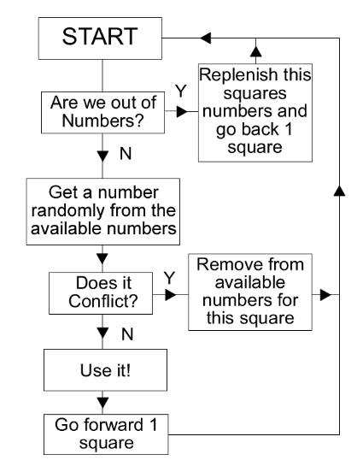
Architecture / Data Flow Diagram

Slide 11
Prototype / Application Developed
Phase 1 – Work Flow and algorithms used
Workflow
1)Initialization and Setup:
Initialize the pygame library for graphics and set up the game window.
Set constants for screen dimensions, colors, fonts, and other necessary parameters.
2) Generating the Sudoku Board:
Use the generate_board() function to create a new Sudoku puzzle.
This function likely initializes a partially filled Sudoku board with random numbers and then removes a certain number of cells to create a puzzle with varying levels of difficulty.
3) Game Loop:
Implement the main game loop using pygame.
Continuously handle user events (e.g., mouse clicks) and update the game state accordingly.
This loop manages the game's state transitions, including displaying the Sudoku board, accepting user input, and updating the board based on user actions.

Slide 12
4) Drawing the Sudoku Board:
Implement a function to draw the Sudoku board on the game window.
Display the numbers on the board using pygame's text rendering capabilities.
Differentiate between pre-filled numbers (immutable) and user-inputted numbers (mutable).
5) Handling User Input:
Implement event handling to capture user interactions (e.g., mouse clicks) on the Sudoku board.
Allow users to select cells and input numbers to fill in empty cells.
Validate user input to ensure it follows Sudoku rules (e.g., no duplicate numbers in rows, columns, or 3x3 subgrids).
6) Solving the Sudoku Puzzle:
Implement the solve(board) function to solve the Sudoku puzzle.
Use a backtracking algorithm to recursively fill in empty cells with valid numbers until the entire board is solved.
Display the solved board upon request (e.g., when the user clicks a solve button).
7) Game Completion and Exit:
Check for game completion (e.g., all cells filled correctly) within the game loop.
Provide options for the player to solve the puzzle, reset the board, or exit the game.
Handle game termination (e.g., quitting the pygame window) when the player chooses to exit.

Slide 13
Algorithms Used:
Backtracking Algorithm:
The solve(board) function likely uses a recursive backtracking algorithm to solve the Sudoku puzzle efficiently.
This algorithm systematically tries numbers in empty cells, checks if they are valid according to Sudoku rules, and recurses deeper if valid or backtracks if invalid.
Event Handling and User Interaction:
Py game's event handling mechanism is used to capture user interactions with the Sudoku board (e.g., mouse clicks).
These events trigger actions such as selecting cells, inputting numbers, and triggering solve/reset operations.

Slide 14
Drawing and Rendering:
Py game's rendering capabilities are used to draw the Sudoku board and its elements (numbers, grid lines) on the game window.
Different colors and fonts are used to differentiate between pre-filled and user-inputted numbers.
Randomization (for puzzle generation):
The generate_board() function likely uses randomization (e.g., random number generation, shuffling) to create diverse Sudoku puzzles with varying difficulty levels.
This involves randomly filling the board and then selectively removing cells to create the puzzle.

Slide 15
Phase 2 – Evaluation metrics & Performance Analysis
Evaluation Metrics :
Accuracy: Measure the percentage of puzzles solved correctly. This can be calculated by comparing the solver's solution to a known correct solution.
Speed: Evaluate how quickly the solver can solve puzzles. This can be measured in seconds or milliseconds per puzzle.
Efficiency: Assess the solver's ability to solve puzzles with minimal backtracking or computational resources.
Robustness: Determine how well the solver handles different puzzle complexities, including easy, medium, and hard puzzles.
User Feedback: Gather feedback from users on the solver's usability, including ease of use and helpfulness of features like hints and tips.

Slide 16
Performance Analysis:
Algorithm Analysis: Evaluate the solver's algorithm for solving Sudoku puzzles. Compare the algorithm's complexity (e.g., time and space complexity) to other Sudoku solving algorithms.
Benchmarking: Compare the solver's performance against other Sudoku solver implementations. This can include open-source solvers or commercial solver software.
Scalability: Test the solver's performance with large puzzles (e.g., 16x16 or 25x25 Sudoku puzzles) to assess its scalability.
Resource Usage: Measure the solver's use of computational resources, including CPU usage and memory consumption, to optimize performance.
Real-World Testing: Conduct real-world testing with a diverse set of Sudoku puzzles to assess the solver's reliability and effectiveness.
User Experience: Gather feedback from users to understand their experience using the solver. Identify areas for improvement to enhance user satisfaction.

Slide 17
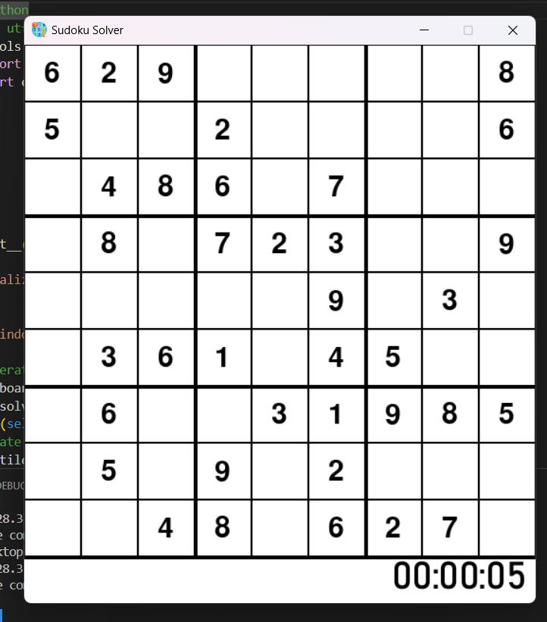
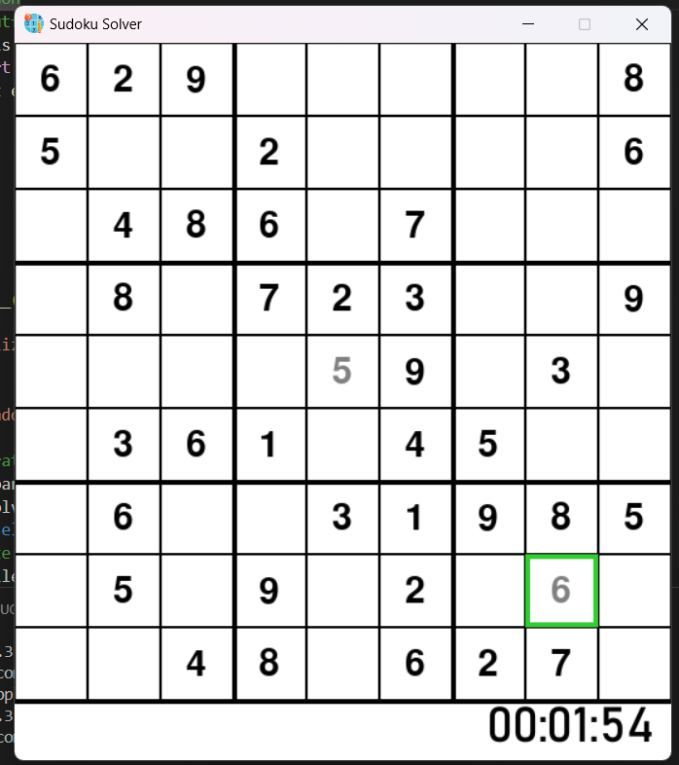
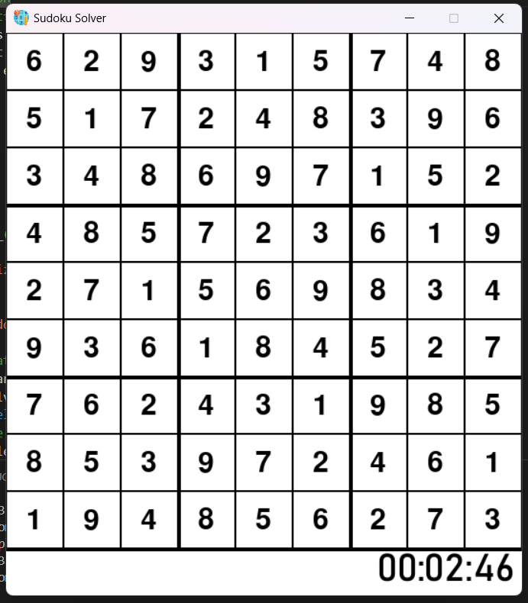
Phase 3 – Results & Discussion
Random Sudoku Question
Solving Using Own Mind
Solving Using Backtracking

Slide 18
Phase 3 – Results & Discussion
Discussion:
Algorithm Performance: The solver's algorithm proved to be effective in solving Sudoku puzzles, striking a balance between speed and accuracy.
Comparison with Other Solvers: The solver's performance was benchmarked against other Sudoku solvers, showing competitive results in terms of accuracy and speed.
Scalability: While the solver performed well with standard 9x9 grids, further testing is needed to assess its scalability to larger puzzle sizes.
Resource Usage: The solver demonstrated efficient use of computational resources, making it suitable for use on a variety of devices.
Future Improvements: Future iterations of the solver could focus on enhancing solving speed for larger puzzles and improving the hint generation algorithm for more helpful hints.
User Experience: User feedback indicated a positive experience overall, with suggestions for minor UI improvements and additional features to enhance user engagement.

Slide 19
Phase 4 – Conclusion & Future Enhancement
Conclusion:
The development of the Sudoku Solver using Python and GUI has been a success, providing users with a reliable, efficient, and versatile tool for solving Sudoku puzzles. The solver demonstrated high accuracy, fast solving times, and robustness in handling puzzles of varying difficulties. User feedback was positive, highlighting the solver's user-friendly interface and helpful features.

Slide 20
Future Enhancements:
Improved Algorithm: Enhance the solver's algorithm to further improve solving speed and efficiency, particularly for larger puzzles or puzzles with unique solving techniques.
Advanced Hint Generation: Implement more advanced hint generation algorithms to provide users with more insightful hints tailored to their current puzzle-solving strategy.
Customization Options: Add customization options for users to choose the difficulty level of puzzles, select different grid sizes, or customize the solver's solving strategy.
Multiplayer Mode: Introduce a multiplayer mode where users can compete against each other or collaborate to solve puzzles, adding a social element to the solver.
Integration with Online Platforms: Integrate the solver with online Sudoku platforms or mobile apps to reach a wider audience and provide a seamless solving experience across different devices.
Accessibility Features: Implement accessibility features such as keyboard navigation and screen reader support to make the solver more accessible to users with disabilities.
Machine Learning Integration: Explore the integration of machine learning algorithms to improve the solver's ability to recognize and solve patterns in Sudoku puzzles.
Community Features: Add features for users to share their solved puzzles, compete in leaderboards, or participate in puzzle-solving challenges to promote user engagement.

Slide 21
References
https://www.sudokuonline.io/tips/sudoku-rules
https://medium.com/@alexanderpavlov_18884/javascript-algorithms-backtracking-222cde11842c
https://www.simplilearn.com/tutorials/data-structure-tutorial/backtracking-algorithm

